Slide 1
Set up React and Understand What you’re building

Slide 2
What is React?
Normally, a webpage might have separate HTML, CSS, and JavaScript:
  HTML → structure
  CSS → appearance
  JavaScript → behavior
React is Javascript library that let us build the webpage out of reuseable components:
  For example, instead of manually creating 100 species cards, we create one SpeciesCard component and React can reuse it for 100 different species

Slide 3
Install Node.js
React development uses Node.js tools
Install the current LTS version of Node.js from Node.js official websites download

Slide 4
Install VS Code
If you don’t already have it, install Visual Studio Code
We will use VS Code to edit the React project

Slide 5
Create our FLL React Project
We’ll use Vite to create the project. It’s a straightforward modern way to start a React application.
Open VS Code and create a new Terminal
Type:
  npm create vite@latest fll-biodiversity-app -- --template react
You should see something similar to:
  VITE ready
  Local: http://localhost:5173/
Hold Ctrl and click the address.
You should see the Vite/React starter webpage.

Slide 6
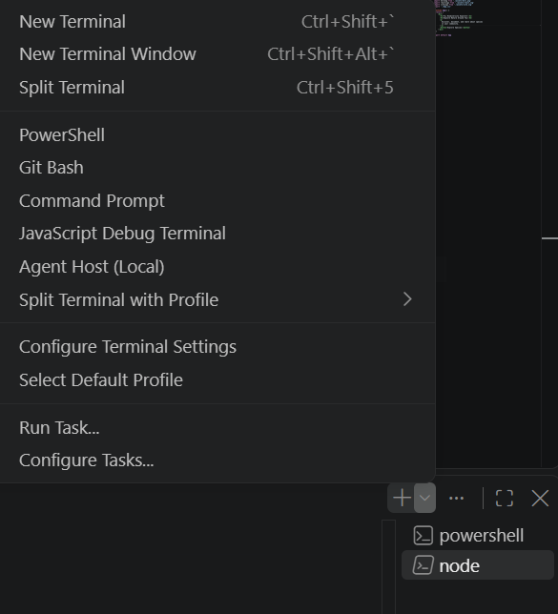
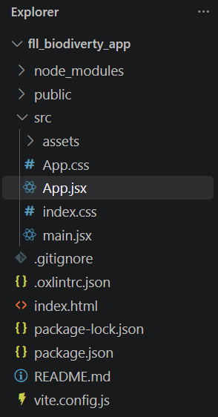
Open the project in VS Code
Go back to power shell
In Terminal, type
  cd fll-biodiversity-app
Use File menu->Open Folder to open the project. You will see

Slide 7
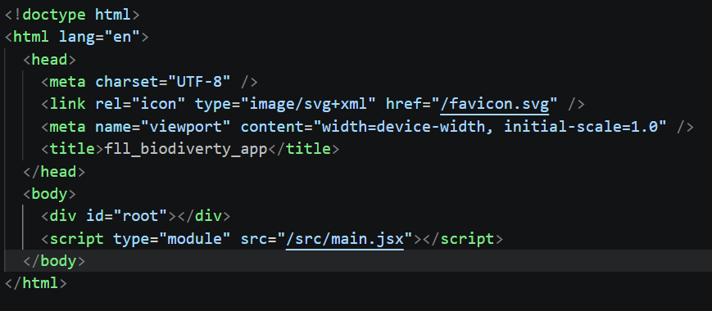
Open the project in VS Code
For now, there are three things worth understanding
  index.html
  This is the basic HTML page. Inside it you’ll find something like:
  <div id="root"></div>
  Think of that as an empty container:
    Browser
    └── index.html
    └── <div id="root">
    ↑
    React puts our
    application here

Slide 8
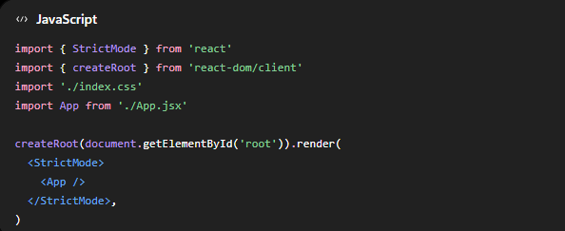
Open the project in VS Code
Main.jsx
  Next open: src/main.jsx
  You’ll see code similar to:
  <App /> means
    Put our App components onto the webpage.

Slide 9
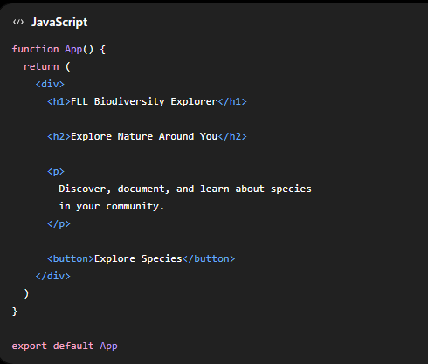
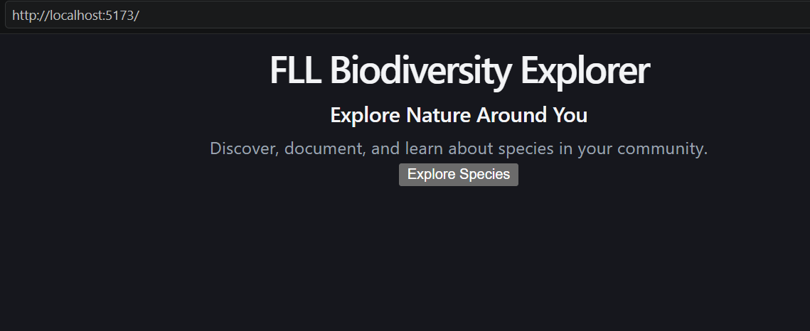
Open the project in VS Code
App.jsx
  Open src/App.jsx
  Delete what’s there and replace it with:
  Save the file.
  In Terminal, type
    npm run dev
  Hold Ctrl and click the address
    http://localhost:5174/
  Look at your browser. Vite should immediately change the page.

Slide 10

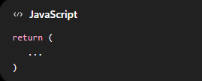
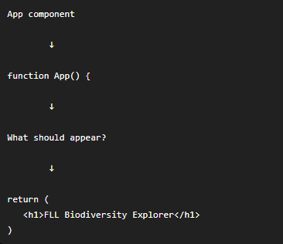
You just created your first component
This creates a React component named App.
And this describes what the component displays.
So conceptually

Slide 11
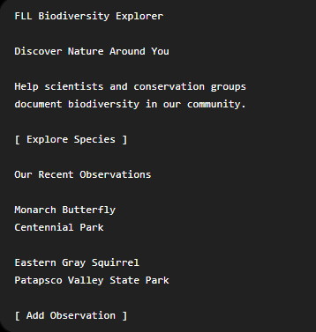
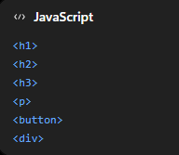

First team challenge
Try creating this:
Use only For example:

Slide 12
Summary
React
  Tool/library we are using to build the interface
Component
  Reusable piece of the interface
JSX
  HTML-like syntax written inside React JavaScript.
App.jsx
  Our main application component.

